Slide 1

Guess The Number Game – Java Swing GUI Application
Your Name : Karan Bhaskar Borkar
Domain Name : Java Development
Date : 15 February

Slide 2
Introduction
The "Guess The Number Game" is a classic desktop game built using Java Swing.
The purpose of this project is to demonstrate fundamental Java programming concepts, GUI development with Swing, and event handling.
What is the Guess The Number Game?
Purpose of the project
A simple, interactive game where players guess a randomly generated number.
To showcase Java Swing for GUI, event handling, and basic game logic implementation.

Slide 3

Technologies Used
Java
Swing (GUI)
AWT
The core programming language for the application logic.
Used for building the graphical user interface components.
Abstract Window Toolkit, foundational for Swing components.
Event Handling
Random Class
Manages user interactions like button clicks and input.
Generates the secret number for the game.

Slide 4
Game Features
Random number generation
Maximum 7 attempts
System generates a random number between 1 and 100.
Players have a limited number of guesses per round.
Score calculation system
Multiple rounds
Points awarded based on remaining attempts.
Players can enjoy continuous gameplay.
User-friendly GUI
Error handling for invalid input
Intuitive interface for easy interaction.
Ensures robust gameplay by managing incorrect entries.

Slide 5
How the Game Works (Flow)
01
02
Start new round
Enter guess
A new random number is generated.
Player inputs their number guess.
03
04
System checks guess
Display hints
Compares player's guess with the random number.
Provides feedback: "Too High" or "Too Low".
05
06
Update score
End round
Adjusts score based on guess outcome.
Round concludes when number is guessed or attempts run out.

Slide 6
Code Structure Overview
Class: GuessTheNumberGame extends JFrame
Key Variables
Important Methods
randomNumber
score
attemptsLeft
round
initComponents()
startNewRound()
actionPerformed()
Main class for the game, inheriting from JFrame for GUI.

Slide 7
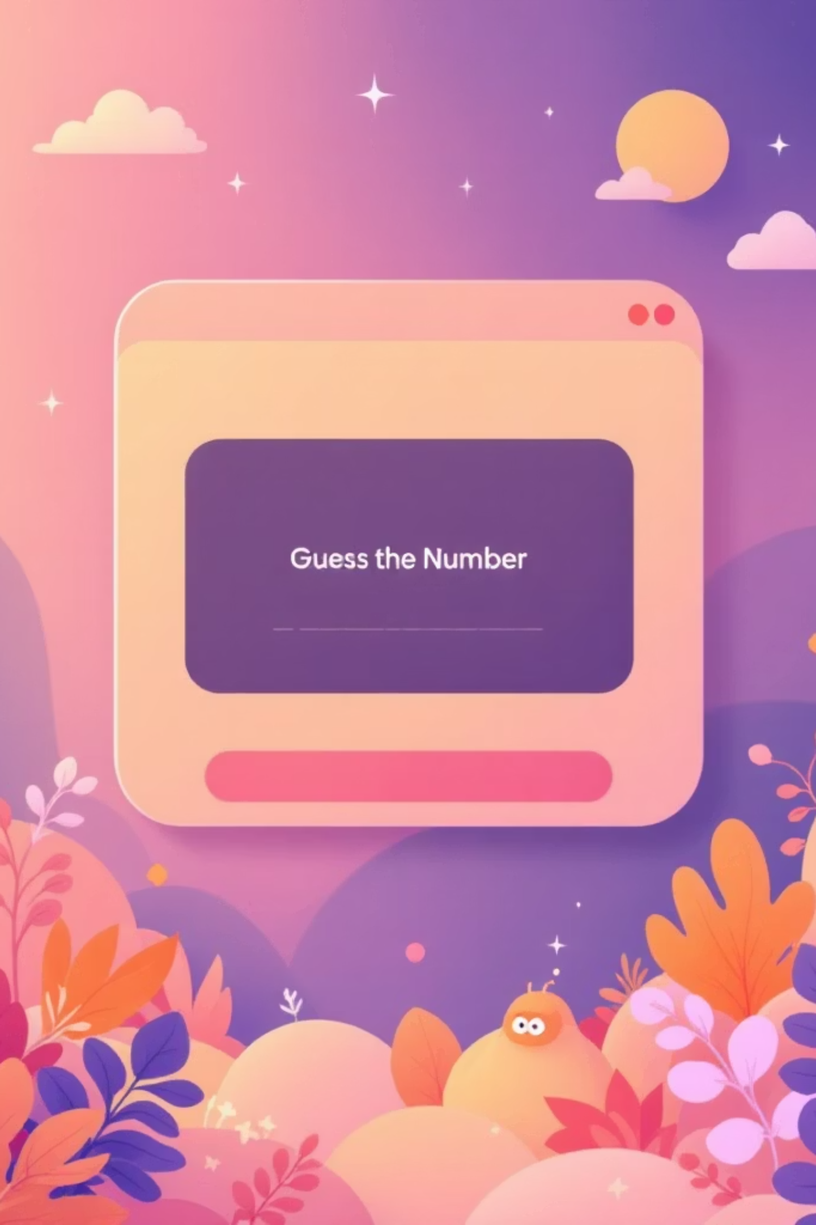
GUI Components Used
JFrame: The main window of the application.
JPanel: Container for organizing other components.
JLabel: Displays text, hints, and game status.
JTextField: Allows players to input their guesses.
JButton: Triggers actions like "Guess" or "New Game".
Layout and colors used: Custom layout with a blue interface for visual appeal.

Slide 8
Score Calculation Logic
Points = attemptsLeft × 10
Score increases after correct guess
More attempts remaining means higher points.
Successfully guessing the number adds to the total score.

Slide 9

Exception Handling
Handling NumberFormatException
Range validation (1–100)
Catches errors when non-numeric input is entered into the guess field.
Ensures that guesses are within the valid range of 1 to 100.

